Slide 1

Bank marketing Analysis using
Machine Learning
#DHEERAJ PRANAV
B. Tech,CSE

Slide 2
Understanding the problem
Problem Statement: Improve marketing campaign of a bank by analyzing their past marketing campaign data and recommending which customer to target
Problem Motivation: By devising such a prediction algorithm, the bank can better target its customers and better channelize its marketing efforts
Banks offered their clients fixed-term products such as CDs. Data was collected about each client, type of contact, and outcome.
What can this data tell us about marketing success for this campaign?
Can these data science techniques be applied to other areas?
#SOURCE OF DATA
https://archive.ics.uci.edu/ml/datasets/Bank+Marketing

Slide 3
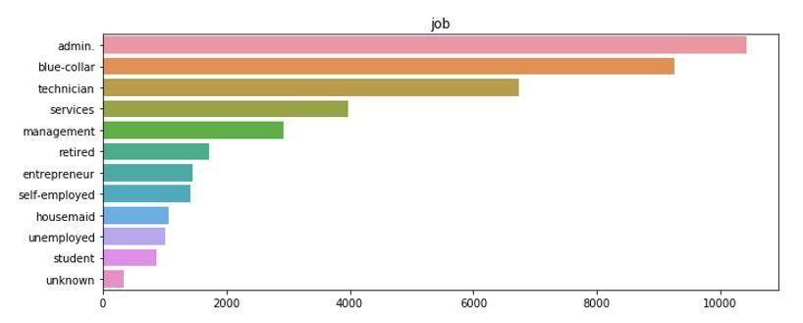
Data Exploration
All coding is done in Python 3.
Extensive use of pandas, numpy, matplotlib, as well as seaborn and sklearn packages.
Dataset contained 19 different features on more than 41,000 clients.
Features were both categorical and numerical. Target variable was binary (“Yes” or “No”).
Pandas package was imported and a dataframe was created.
Categorical variables were looked at first. Visualizations were created using the seaborn package.
#DRIVE LINK OF EXPLANATION
https://drive.google.com/drive/my-drive?tid=0By9jKmOK17EVZmxsZ1BBX2J3enM

Slide 4
Data Preperation
Many features had missing values. How do we handle this?
For categorical features, imputation using other independent variables. For example, cross-tabulation between 'job' and 'education'; 'age' and 'job'; 'home ownership' and 'loan status.'
Among numerical features, fortunately only column (‘pdays’) had any missing values. Unfortunately, missing values made up the majority of the column.
To handle this, ‘pdays’ was converted from a numerical feature to a categorical feature using buckets: < 5 days, 6-15 days, etc.
Heatmap using seaborn package was created to show us any particularly strong correlations between the independent variables and the target variable outcome.

Slide 5
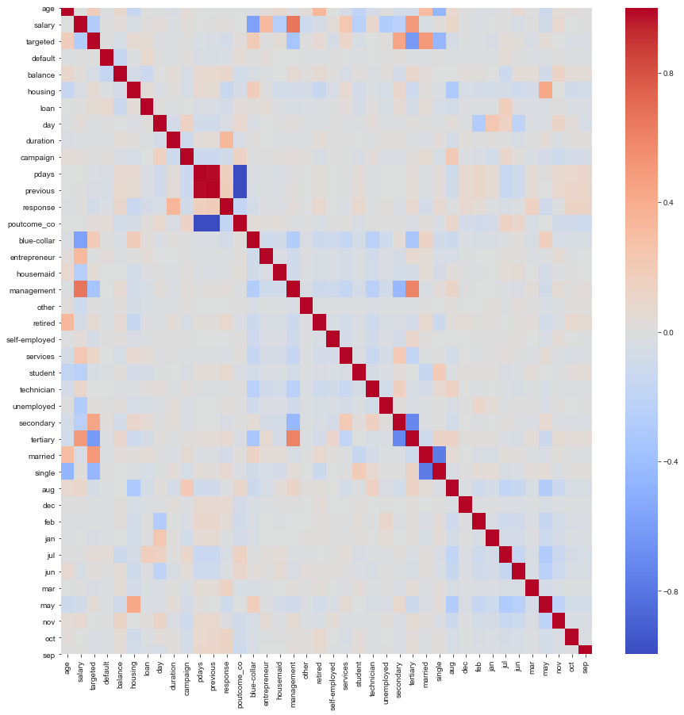
Correlation Heat map:

Slide 6
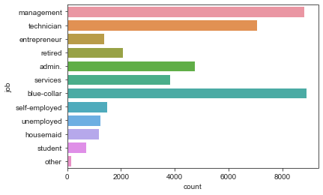
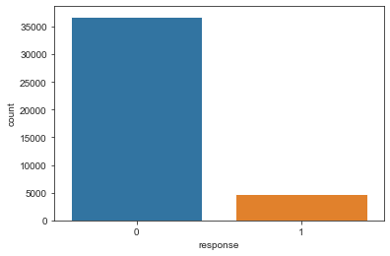
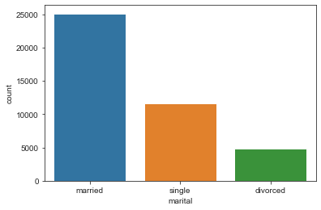
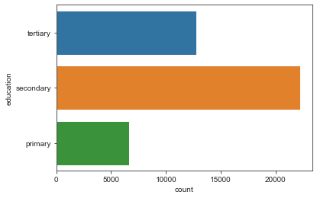
Plots for Categorical Data

Slide 7
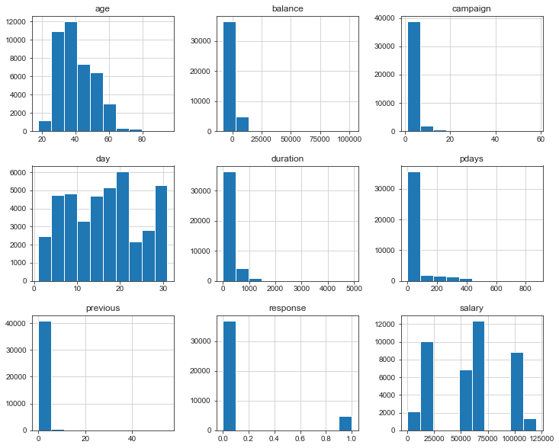
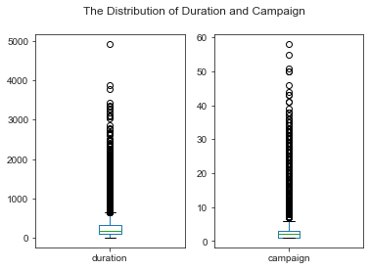
Visualizations for Numerical Data

Slide 8
Model Building
Logistic Regression
Random Forest
sklearn.linear_model.LogisticRegression
Its a classification model though name is Logistic regression
Fits a sigmoid function to a data
Outputs probability which is in [0,1] range unlike linear models.
Sklearn.ensemble.RandomForestclassifier
Constructs multiple decision trees and takes the mode of those trees for an example to make the final decision
Individual Trees are intentionally over fit and validation set is used to optimize the forest level parameters

Slide 9
The dataset is divided into training data and test data.
With the intention of using the training data to find the parameters of the particular model being used (fitting the model on the training data) and then applying this to the test data to determine the model’s performance .
And to draw conclusions about its predictive capability.
This can be done with a sklearn.cross validation.train test split function call by specifying split ratio.

Slide 10
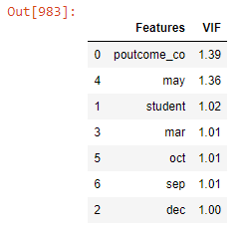
Feature Selection
Significant features are detected and selected using various methods during mode building:
1.Recursive Feature Elimination
2.Variancce inflation factor
3.OLS (p values)
Significant features are:
['poutcome_co',
'student',
‘month_dec',
'month_mar',
'month_may',
'month_oct',
'month_sep']

Slide 11
Model Evaluation
Model’s of different types of algorithms are evaluated based on different metrics , here we have used :
1. Accuracy Score
2. Precision and Recall
3. K-Fold ( cross validation score)
logistic regression achieved an accuracy of about 88%, suggesting a high level of strength of this model to classify the customer response given all the defined customer features.
Random forest has also got somehow similar accuracy.

Slide 12
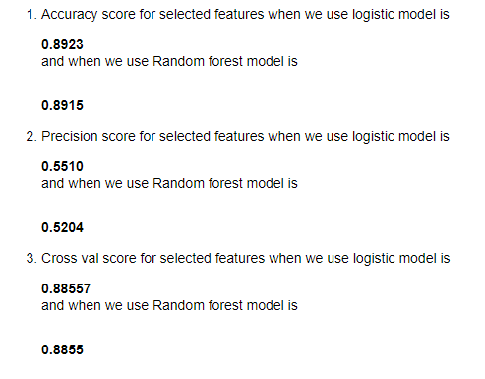
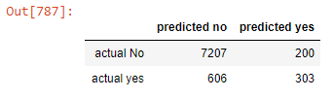
Accuracy Measures
#Confusion Matrix

Slide 13
CONCLUSION
According to previous analysis, a target customer profile can be established. The most responsive customers possess these features:
Feature 1: age < 30 or age > 60
Feature 2: students or retired people
Feature 3: specific months (dec , mar , may ,oct )
By applying logistic and Random forest classification algorithms estimation model were successfully built. With these two models, the bank will be able to predict a customer's response to its telemarketing campaign before calling this customer. In this way, the bank can allocate more marketing efforts to the clients who are classified as highly likely to accept term deposits, and call less to those who are unlikely to make term deposits.
#Recommendations
Try to engage customers and have longer calls
Preferably use Telephone as the mode of contact
Prioritize those customers to who were part of the previous marketing campaigns.

Slide 14
Thank You.

